Slide 1



DEBBIE SMITH
ATHLETICS

Slide 2


INTRODUCTION
Mike Gifford: Principal
Kara Lee: Assistant Principal
Matt Rowe: Dean of Students
Bo Sellers: Athletic Director
Kim Boldi: Athletic Secretary

Slide 3
DS SPORTS
Fall Sports
Cheer, Cross Country, Golf-Girls, Soccer, Tennis, Volleyball
Winter Sports
Cheer, Basketball, Ski, Wrestling
Spring Sports
Golf-Boys, Softball, Swim, Track & Field

Slide 4
REQUIREMENTS
Complete Register My Athlete(Aktivate)
Have a current Athletic Physical
Pay all Athletic Fees to DS
Complete ImPACT Test
Have a 2.0 GPA from previous semester

Slide 5
FEES
$50 Transportation fee(once each year)
$25 Activity Fee
$10 Training Room Fee
$15 ImPACT Fee
$50 Green Fee-Golf only
TBD: Team Specific Fees

Slide 6
Wooster High School Athletic Night
Thursday May 29
4-8 in the Large Gym
Physicals $25.00 & Immunization Clinic
(You Must Be Accompanied with a
Parent or Legal Guardian)

Slide 7
FAQS
We compete in the NIAA 3A
We are immediately eligible for the post season
We offer all sports but football and baseball
You can still play football or baseball at your zoned school
Fall Practice Begins August 2nd, 2025
Summer Workouts may occur if construction is complete
RMA/Aktivate must be completed

Slide 8
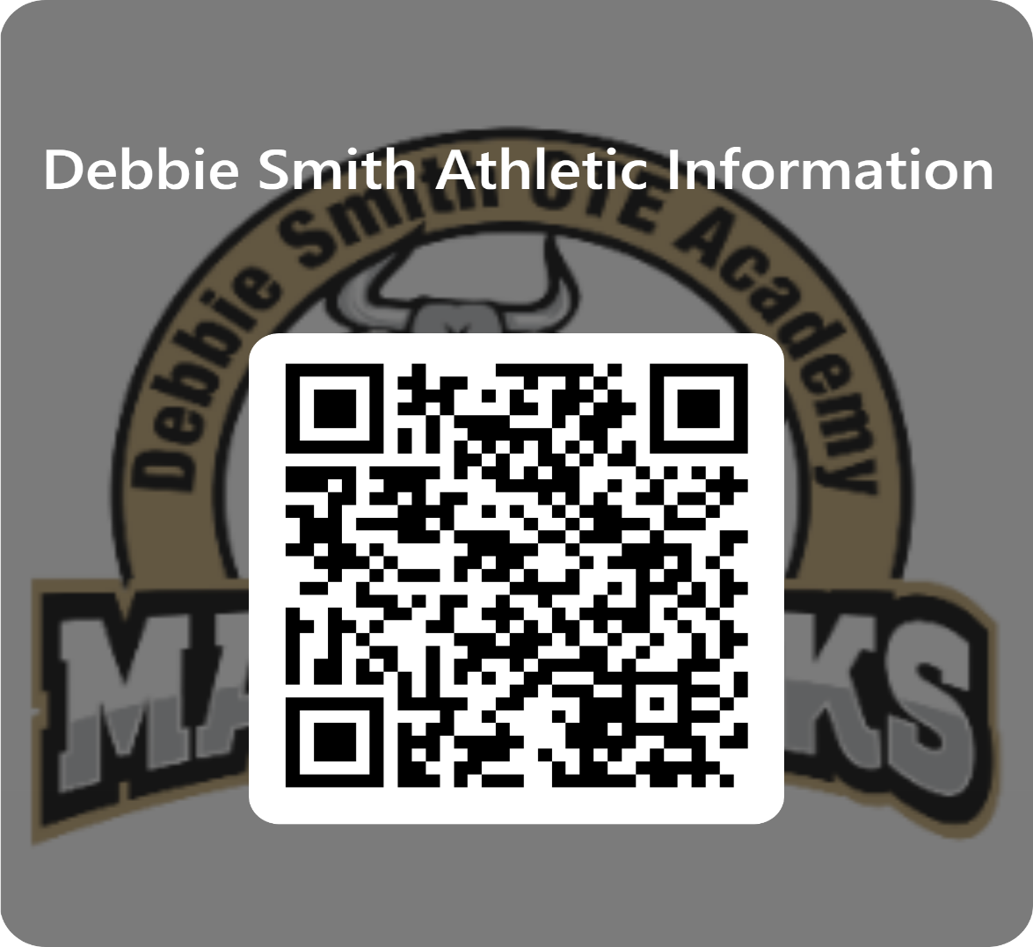
TONIGHT
Please scan the QR Code and fill out the information

Slide 9
Important Information
DS Website:
www.washschools.net/debbiesmith
Calendar: https://www.washoeschools.net/Pages/20482
NIAA:
www.niaa.com

Slide 10
COACHES
Many of your coaches are here tonight to meet you now. Please go to their table to talk with them
If your coach is not here, their email is on the packet you received tonight.

Slide 11
THANK YOU

